Slide 1
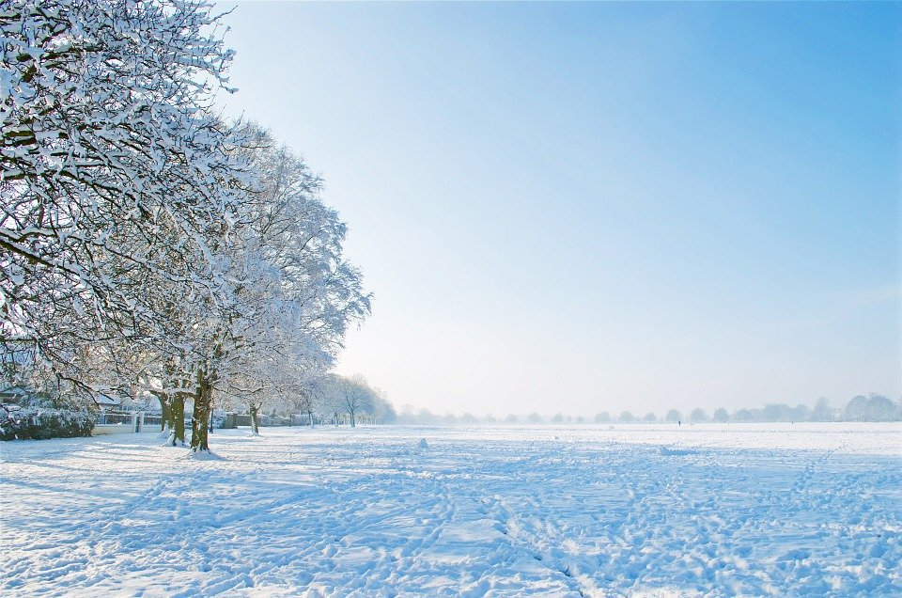
Closed
due to weather conditions
To preserve the safety of our guests
and to protect the greens and fairways
the course is closed today.
The driving range may be open!
If the clubhouse is open, please check with the staff in the Pro shop.

